Slide 1
Production and Growth
© 2015 Cengage Learning. All Rights Reserved. May not be copied, scanned, or duplicated, in whole or in part, except for use as permitted in a license distributed with a certain product or service or otherwise on a password-protected website for classroom use.

Slide 2
Economic Growth
Real GDP per person
  Living standard
  Vary widely from country to country
Growth rate
  How rapidly real GDP per person grew in the typical year
Because of differences in growth rates
  Ranking of countries by income changes substantially over time
© 2015 Cengage Learning. All Rights Reserved. May not be copied, scanned, or duplicated, in whole or in part, except for use as permitted in a license distributed with a certain product or service or otherwise on a password-protected website for classroom use.

Slide 3
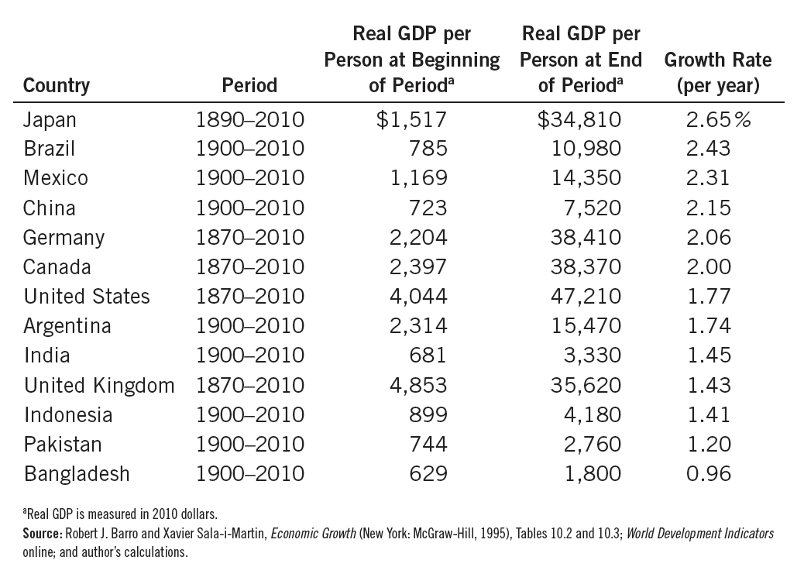
Table 1
The Variety of Growth Experiences
© 2015 Cengage Learning. All Rights Reserved. May not be copied, scanned, or duplicated, in whole or in part, except for use as permitted in a license distributed with a certain product or service or otherwise on a password-protected website for classroom use.

Slide 4
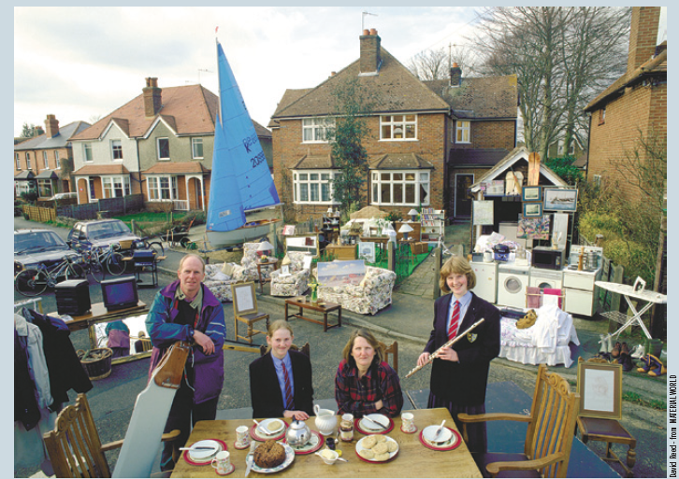
A Picture Is Worth a Thousand Statistics
The United Kingdom is an advanced economy. In 2011, its GDP per person was $36,010. A negligible share of the population lives in extreme poverty, defined here as less than $2 a day. A baby born in the United Kingdom can expect a relatively healthy childhood: Only 5 out of 1,000 children die before reaching age 5. Educational attainment is high: Among children of high school age, 98 percent are in school.
© 2015 Cengage Learning. All Rights Reserved. May not be copied, scanned, or duplicated, in whole or in part, except for use as permitted in a license distributed with a certain product or service or otherwise on a password-protected website for classroom use.

Slide 5

A Picture Is Worth a Thousand Statistics
Mexico is a middle-income country. In 2011, its GDP per person was $15,390. About 5 percent of the population lives on less than $2 a day, and 16 out of 1,000 children die before age 5. Among those of high school age, 71 percent are in school
© 2015 Cengage Learning. All Rights Reserved. May not be copied, scanned, or duplicated, in whole or in part, except for use as permitted in a license distributed with a certain product or service or otherwise on a password-protected website for classroom use.

Slide 6
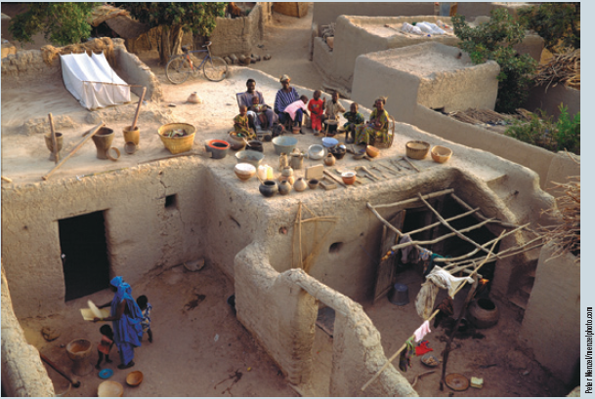
A Picture Is Worth a Thousand Statistics
Mali is a poor country. In 2011, its GDP per person was only $1,040. Extreme poverty is the norm: More than three-quarters of the population lives on less than $2 per day. Life is often cut short: 176 out of 1,000 children die before age 5. And educational attainment in Mali is low: Among those of high school age, only 31 percent are in school.
© 2015 Cengage Learning. All Rights Reserved. May not be copied, scanned, or duplicated, in whole or in part, except for use as permitted in a license distributed with a certain product or service or otherwise on a password-protected website for classroom use.

Slide 7
Productivity
Productivity
  Quantity of goods and services
  Produced from each unit of labor input
Why productivity is so important
  Key determinant of living standards
  Growth in productivity is the key determinant of growth in living standards
  An economy’s income is the economy’s output
© 2015 Cengage Learning. All Rights Reserved. May not be copied, scanned, or duplicated, in whole or in part, except for use as permitted in a license distributed with a certain product or service or otherwise on a password-protected website for classroom use.

Slide 8
Productivity
Determinants of productivity
  Physical capital per worker
  Human capital per worker
  Natural resources per worker
  Technological knowledge
© 2015 Cengage Learning. All Rights Reserved. May not be copied, scanned, or duplicated, in whole or in part, except for use as permitted in a license distributed with a certain product or service or otherwise on a password-protected website for classroom use.

Slide 9
Productivity
Physical capital
  Stock of equipment and structures
  Used to produce goods and services
Human capital
  Knowledge and skills that workers acquire through education, training, and experience
© 2015 Cengage Learning. All Rights Reserved. May not be copied, scanned, or duplicated, in whole or in part, except for use as permitted in a license distributed with a certain product or service or otherwise on a password-protected website for classroom use.

Slide 10
Productivity
Natural resources
  Inputs into the production of goods and services
  Provided by nature, such as land, rivers, and mineral deposits
Technological knowledge
  Society’s understanding of the best ways to produce goods and services
© 2015 Cengage Learning. All Rights Reserved. May not be copied, scanned, or duplicated, in whole or in part, except for use as permitted in a license distributed with a certain product or service or otherwise on a password-protected website for classroom use.

Slide 11
Are natural resources a limit to growth?
Argument
  Natural resources - will eventually limit how much the world’s economies can grow
    Fixed supply of nonrenewable natural resources – will run out
    Stop economic growth
    Force living standards to fall
© 2015 Cengage Learning. All Rights Reserved. May not be copied, scanned, or duplicated, in whole or in part, except for use as permitted in a license distributed with a certain product or service or otherwise on a password-protected website for classroom use.

Slide 12
Are natural resources a limit to growth?
Technological progress
  Often yields ways to avoid these limits
    Improved use of natural resources over time
    Recycling
    New materials
Are these efforts enough to permit continued economic growth?
© 2015 Cengage Learning. All Rights Reserved. May not be copied, scanned, or duplicated, in whole or in part, except for use as permitted in a license distributed with a certain product or service or otherwise on a password-protected website for classroom use.

Slide 13
Are natural resources a limit to growth?
Prices of natural resources
  Scarcity - reflected in market prices
  Natural resource prices
    Substantial short-run fluctuations
    Stable or falling - over long spans of time
  Our ability to conserve these resources
    Growing more rapidly than their supplies are dwindling
© 2015 Cengage Learning. All Rights Reserved. May not be copied, scanned, or duplicated, in whole or in part, except for use as permitted in a license distributed with a certain product or service or otherwise on a password-protected website for classroom use.

Slide 14
Saving and Investment
Raise future productivity
  Invest more current resources in the production of capital
  Trade-off
    Devote fewer resources to produce goods and services for current consumption
© 2015 Cengage Learning. All Rights Reserved. May not be copied, scanned, or duplicated, in whole or in part, except for use as permitted in a license distributed with a certain product or service or otherwise on a password-protected website for classroom use.

Slide 15
Diminishing Returns
Higher savings rate
  Fewer resources – used to make consumption goods
  More resources – to make capital goods
  Capital stock increases
  Rising productivity
  More rapid growth in GDP
© 2015 Cengage Learning. All Rights Reserved. May not be copied, scanned, or duplicated, in whole or in part, except for use as permitted in a license distributed with a certain product or service or otherwise on a password-protected website for classroom use.

Slide 16
Diminishing Returns
Diminishing returns
  Benefit from an extra unit of an input
  Declines as the quantity of the input increases
In the long run, higher savings rate
  Higher level of productivity
  Higher level of income
  Not higher growth in productivity or income
© 2015 Cengage Learning. All Rights Reserved. May not be copied, scanned, or duplicated, in whole or in part, except for use as permitted in a license distributed with a certain product or service or otherwise on a password-protected website for classroom use.

Slide 17
Figure 1
Illustrating the Production Function
Output
per Worker
1
2. When the economy has a high level of capital, an extra unit of capital leads to a small increase in output.
1. When the economy has a low level of capital, an extra unit of capital leads to a large increase in output.
1
Output per Worker
This figure shows how the amount of capital per worker influences the amount of output per worker. Other determinants of output, including human capital, natural resources, and technology, are held constant. The curve becomes flatter as the amount of capital increases because of diminishing returns to capital.
© 2015 Cengage Learning. All Rights Reserved. May not be copied, scanned, or duplicated, in whole or in part, except for use as permitted in a license distributed with a certain product or service or otherwise on a password-protected website for classroom use.

Slide 18
Diminishing Returns
Catch-up effect
  Countries that start off poor
  Tend to grow more rapidly than countries that start off rich
Poor countries
  Low productivity
  Even small amounts of capital investment
    Increase workers’ productivity substantially
© 2015 Cengage Learning. All Rights Reserved. May not be copied, scanned, or duplicated, in whole or in part, except for use as permitted in a license distributed with a certain product or service or otherwise on a password-protected website for classroom use.

Slide 19
Diminishing Returns
Rich countries
  High productivity
  Additional capital investment
    Small effect on productivity
Poor countries
  Tend to grow faster than rich countries
© 2015 Cengage Learning. All Rights Reserved. May not be copied, scanned, or duplicated, in whole or in part, except for use as permitted in a license distributed with a certain product or service or otherwise on a password-protected website for classroom use.

Slide 20
Investment from Abroad
Investment from abroad
  Another way for a country to invest in new capital
  Foreign direct investment
    Capital investment that is owned and operated by a foreign entity
  Foreign portfolio investment
    Investment financed with foreign money but operated by domestic residents
© 2015 Cengage Learning. All Rights Reserved. May not be copied, scanned, or duplicated, in whole or in part, except for use as permitted in a license distributed with a certain product or service or otherwise on a password-protected website for classroom use.

Slide 21
Investment from Abroad
Benefits from investment
  Some flow back to the foreign capital owners
  Increase the economy’s stock of capital
  Higher productivity
  Higher wages
  State-of-the-art technologies
© 2015 Cengage Learning. All Rights Reserved. May not be copied, scanned, or duplicated, in whole or in part, except for use as permitted in a license distributed with a certain product or service or otherwise on a password-protected website for classroom use.

Slide 22
Investment from Abroad
World Bank
  Encourages flow of capital to poor countries
  Funds from world’s advanced countries
  Makes loans to less developed countries
    Roads, sewer systems, schools, other types of capital
  Advice about how the funds might best be used
© 2015 Cengage Learning. All Rights Reserved. May not be copied, scanned, or duplicated, in whole or in part, except for use as permitted in a license distributed with a certain product or service or otherwise on a password-protected website for classroom use.

Slide 23
Investment from Abroad
World Bank and the International Monetary Fund
  Set up after World War II
  Economic distress leads to:
    Political turmoil, international tensions, and military conflict
  Every country has an interest in promoting economic prosperity around the world
© 2015 Cengage Learning. All Rights Reserved. May not be copied, scanned, or duplicated, in whole or in part, except for use as permitted in a license distributed with a certain product or service or otherwise on a password-protected website for classroom use.

Slide 24
Education
Education
  Investment in human capital
  Gap between wages of educated and uneducated workers
  Opportunity cost: wages forgone
  Conveys positive externalities
  Public education - large subsidies to human-capital investment
Problem for poor countries: Brain drain
© 2015 Cengage Learning. All Rights Reserved. May not be copied, scanned, or duplicated, in whole or in part, except for use as permitted in a license distributed with a certain product or service or otherwise on a password-protected website for classroom use.

Slide 25
Health and Nutrition
Human capital
  Education
  Expenditures that lead to a healthier population
Healthier workers
  More productive
Wages
  Reflect a worker’s productivity
© 2015 Cengage Learning. All Rights Reserved. May not be copied, scanned, or duplicated, in whole or in part, except for use as permitted in a license distributed with a certain product or service or otherwise on a password-protected website for classroom use.

Slide 26
Health and Nutrition
Right investments in the health of the population
  Increase productivity
  Raise living standards
Historical trends: long-run economic growth
  Improved health – from better nutrition
  Taller workers – higher wages – better productivity
© 2015 Cengage Learning. All Rights Reserved. May not be copied, scanned, or duplicated, in whole or in part, except for use as permitted in a license distributed with a certain product or service or otherwise on a password-protected website for classroom use.

Slide 27
Health and Nutrition
Vicious circle in poor countries
  Poor countries are poor
    Because their populations are not healthy
  Populations are not healthy
    Because they are poor and cannot afford better healthcare and nutrition
© 2015 Cengage Learning. All Rights Reserved. May not be copied, scanned, or duplicated, in whole or in part, except for use as permitted in a license distributed with a certain product or service or otherwise on a password-protected website for classroom use.

Slide 28
Health and Nutrition
Virtuous circle
  Policies that lead to more rapid economic growth
  Would naturally improve health outcomes
  Which in turn would further promote economic growth
© 2015 Cengage Learning. All Rights Reserved. May not be copied, scanned, or duplicated, in whole or in part, except for use as permitted in a license distributed with a certain product or service or otherwise on a password-protected website for classroom use.

Slide 29
Property Rights, Political Stability
To foster economic growth
  Protect property rights
    Ability of people to exercise authority over the resources they own
    Courts – enforce property rights
  Promote political stability
Property rights
  Prerequisite for the price system to work
© 2015 Cengage Learning. All Rights Reserved. May not be copied, scanned, or duplicated, in whole or in part, except for use as permitted in a license distributed with a certain product or service or otherwise on a password-protected website for classroom use.

Slide 30
Property Rights, Political Stability
Lack of property rights
  Major problem
  Contracts are hard to enforce
  Fraud goes unpunished
  Corruption
    Impedes the coordinating power of markets
    Discourages domestic saving
    Discourages investment from abroad
© 2015 Cengage Learning. All Rights Reserved. May not be copied, scanned, or duplicated, in whole or in part, except for use as permitted in a license distributed with a certain product or service or otherwise on a password-protected website for classroom use.

Slide 31
Property Rights, Political Stability
Political instability
  A threat to property rights
  Revolutions and coups
  Revolutionary government might confiscate the capital of some businesses
  Domestic residents - less incentive to save, invest, and start new businesses
  Foreigners - less incentive to invest
© 2015 Cengage Learning. All Rights Reserved. May not be copied, scanned, or duplicated, in whole or in part, except for use as permitted in a license distributed with a certain product or service or otherwise on a password-protected website for classroom use.

Slide 32
Free Trade
Inward-oriented policies
  Avoid interaction with the rest of the world
  Infant-industry argument
    Tariffs
    Other trade restrictions
  Adverse effect on economic growth
© 2015 Cengage Learning. All Rights Reserved. May not be copied, scanned, or duplicated, in whole or in part, except for use as permitted in a license distributed with a certain product or service or otherwise on a password-protected website for classroom use.

Slide 33
Free Trade
Outward-oriented policies
  Integrate into the world economy
  International trade in goods and services
  Economic growth
Amount of trade – determined by
  Government policy
  Geography
    Easier to trade for countries with natural seaports
© 2015 Cengage Learning. All Rights Reserved. May not be copied, scanned, or duplicated, in whole or in part, except for use as permitted in a license distributed with a certain product or service or otherwise on a password-protected website for classroom use.

Slide 34
Research and Development
Knowledge – public good
  Government – encourages research and development
    Farming methods
    Aerospace research (Air Force; NASA)
    Research grants
      National Science Foundation
      National Institutes of Health
    Tax breaks
    Patent system
© 2015 Cengage Learning. All Rights Reserved. May not be copied, scanned, or duplicated, in whole or in part, except for use as permitted in a license distributed with a certain product or service or otherwise on a password-protected website for classroom use.

Slide 35
Population Growth
Large population
  More workers to produce goods and services
    Larger total output of goods and services
  More consumers
Stretching natural resources
  Malthus: an ever-increasing population
    Strain society’s ability to provide for itself
    Mankind - doomed to forever live in poverty
© 2015 Cengage Learning. All Rights Reserved. May not be copied, scanned, or duplicated, in whole or in part, except for use as permitted in a license distributed with a certain product or service or otherwise on a password-protected website for classroom use.

Slide 36
Population Growth
Diluting the capital stock
  High population growth
    Spread the capital stock more thinly
    Lower productivity per worker
    Lower GDP per worker
Reducing the rate of population growth
  Government regulation
  Increased awareness of birth control
  Equal opportunities for women
© 2015 Cengage Learning. All Rights Reserved. May not be copied, scanned, or duplicated, in whole or in part, except for use as permitted in a license distributed with a certain product or service or otherwise on a password-protected website for classroom use.

Slide 37
Population Growth
Promoting technological progress
  World population growth
    Engine for technological progress and economic prosperity
    More people = More scientists, more inventors, more engineers
© 2015 Cengage Learning. All Rights Reserved. May not be copied, scanned, or duplicated, in whole or in part, except for use as permitted in a license distributed with a certain product or service or otherwise on a password-protected website for classroom use.

